Slide 1
Bear Quest
A Text-based baylor undergrad role-playing game

Slide 2
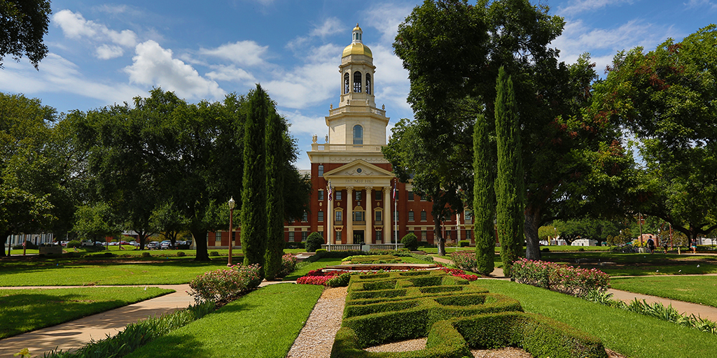
Story
Bear Quest will have a fun, light story that follows an undergraduate Computer Science student through their days of school.
There will be lots of puns, fun characters, and even some teacher cameos!
The story will be told through gameplay and various character interactions as the player progresses through the levels of the game.

Slide 3
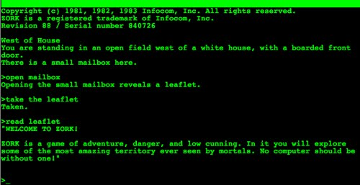
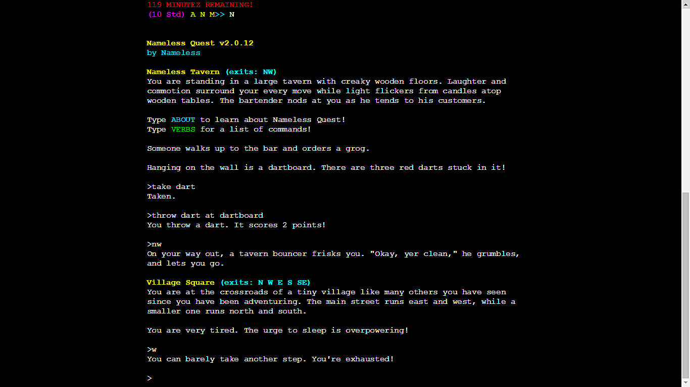
Gameplay
Bear Quest is fully text-based, though graphics may be integrated through clever character use.
There will be an in-depth battle system involving attacks and abilities, allowing the player to battle their way through Baylor classes such as Software Engineering I.
An overworld containing the different Baylor buildings we are all familiar with will be created either through text characters or sentence prompts. Want to go into the Cashion lab in the game WHILE you play the game in the lab? You can!

Slide 4


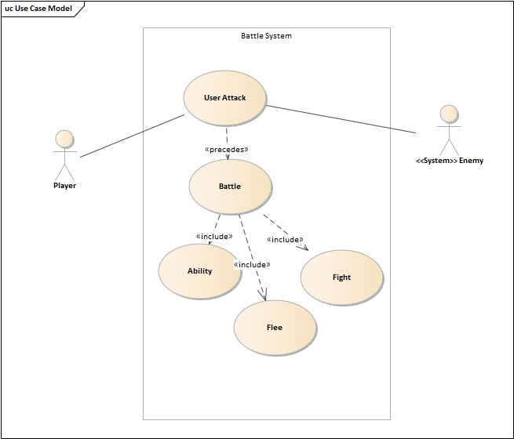



Analysis Files

Slide 5
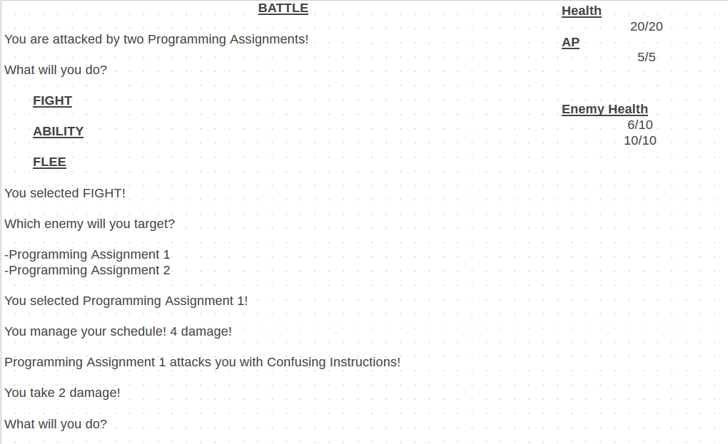
Battle Window Example

Slide 6
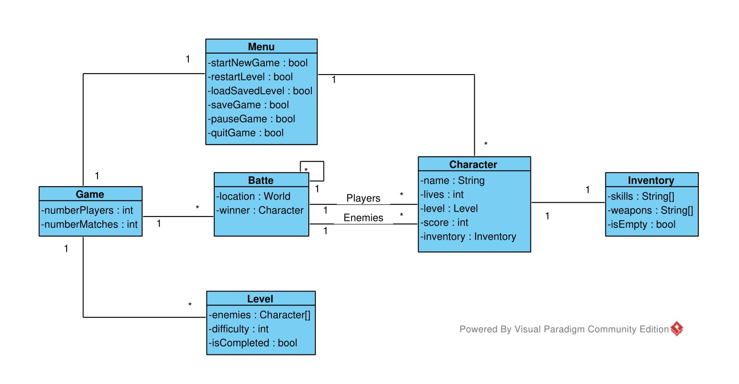
Domain Model

Slide 7
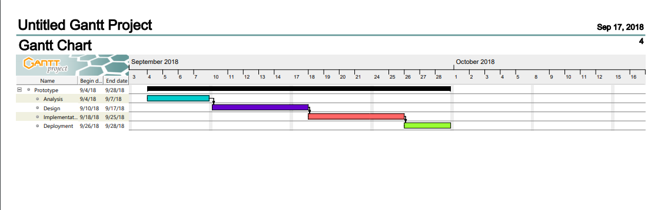
Gantt Diagram

Slide 8
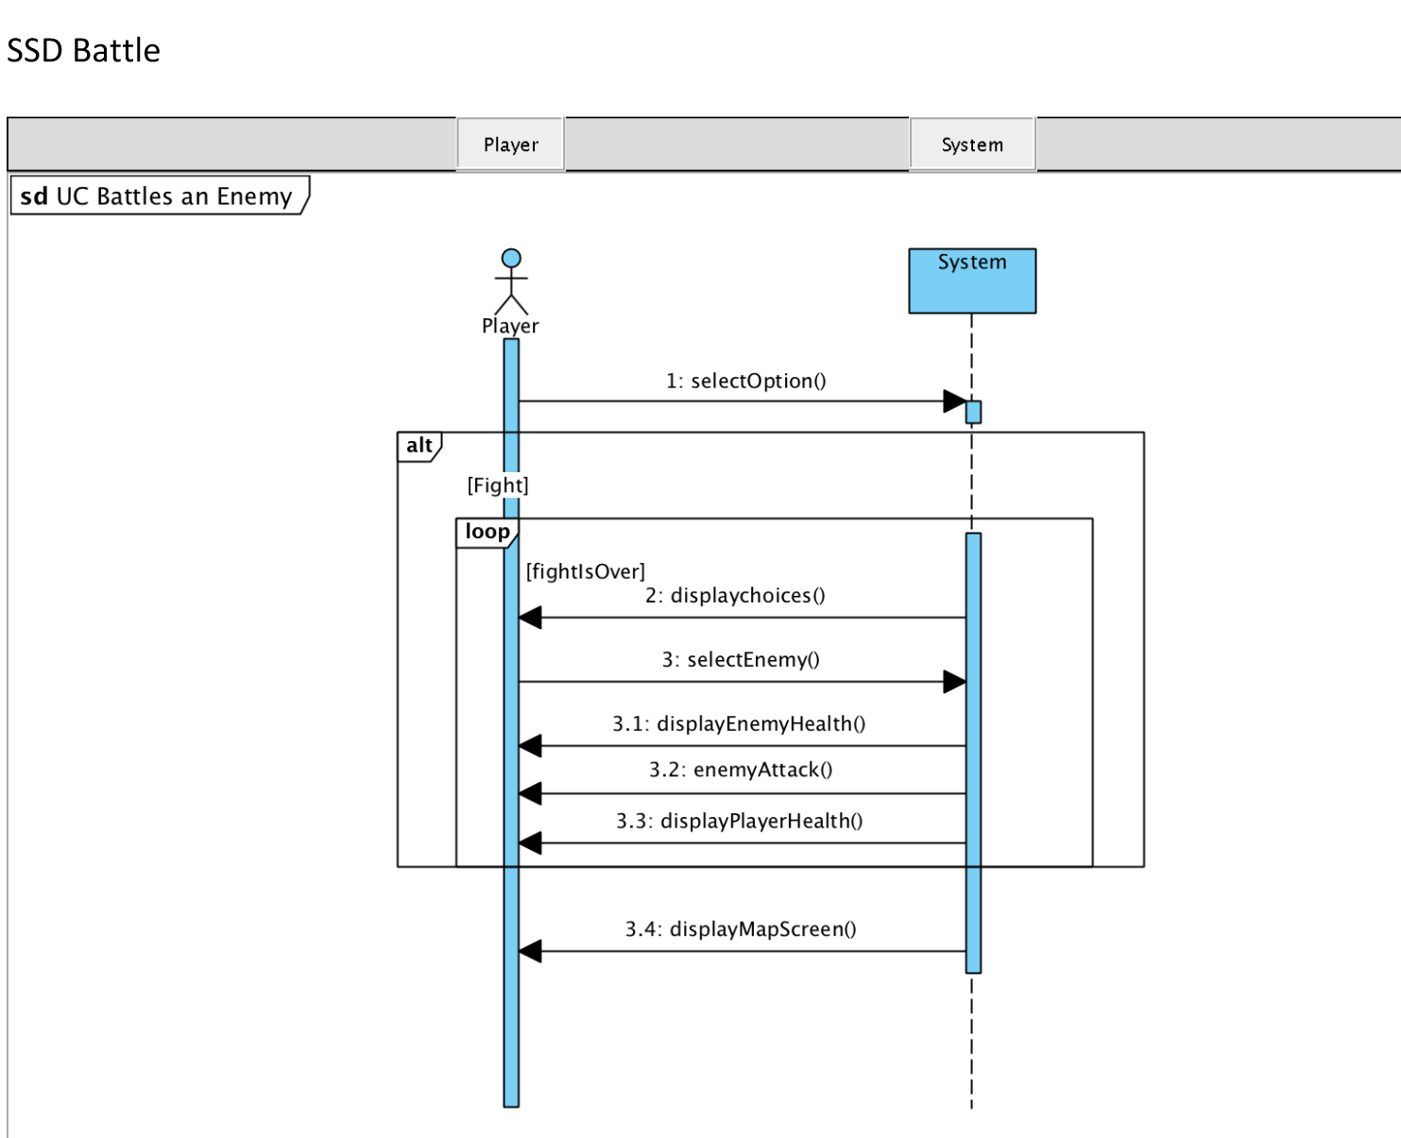
System Sequence Diagram

Slide 9
Links and Credits
https://github.com/cameron1701/BaylorRPG
https://github.com/cameron1701/BaylorRPG/wiki
Team Members:
Arantxa Rodriguez
Zee Dugar
Mark DeJarnett
Matthew Darby
Cameron Cole

